Slide 1
Every Student Succeeds Act
ESSA Impact on Health and Physical Education
Opportunities for ARKANSAS!

Slide 2
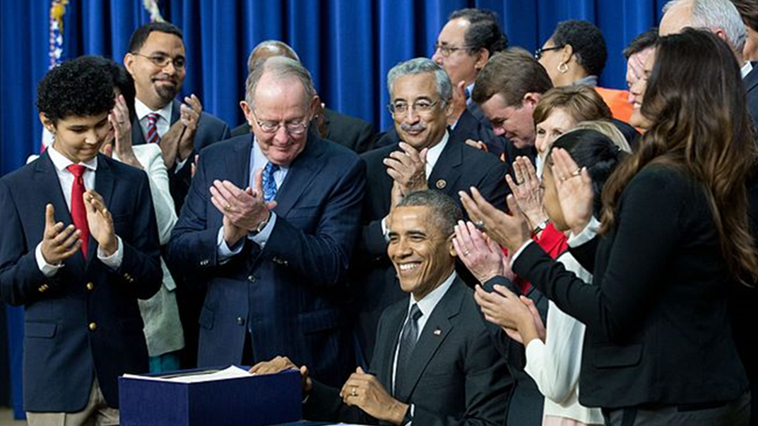
new federal education law is passed!

Slide 3

The Long and Winding Road
2002: No Child Left Behind leaves health and physical education behind resulting in funding & program cuts
2002-2015: PEP grant advocacy is ongoing during this time period to retain only access to federal physical education funding
2010: PHYSICAL Act introduced
SHAPE America champions legislation to elevate physical and health education to “core subjects” under federal education law
2015: Every Student Succeeds Act passed!
Health and physical education are included as
part of the definition of a “well-rounded
education” which replaces term “core subjects”
10 Years of Advocacy
for Health and
Physical Education

Slide 4
ESSA Changes the Game
Sets new framework and funding
for elementary and secondary education and shifts focus to a “well-rounded education” for all students

Slide 5
Health & Physical Education in ESSA
Included in well-rounded education
Replaces term “core subjects” from NCLB
Provides access to federal education funding
Title IV, Part A state block grants priority

Slide 6
Well-Rounded Education
English ~ reading/language arts ~ writing ~ science technology ~ engineering ~ mathematics ~ civics and government ~ economics ~ geography ~ foreign languages ~ computer science ~ arts ~ history
career and technical education ~ music
health and physical education.
18 subjects!

Slide 7
ESSA Basics
Government authority – shift to states & school districts
Standards and assessments set by states
Elimination of AYP & HQT – states will set benchmarks and teacher qualifications
Consolidation of programs (like PEP)
Flexibility in funding

Slide 8

Implementation of ESSA
States and school districts are creating plans NOW
2016–2017 school year is transition year
Funding for 2016–2017 school year under NCLB formulas
ESSA formula funding (Titles I, II, IV) allocated to states July 2017
States will submit plans to US Department of Education by September 2017

Slide 9

ESSA Funding Opportunities for HPE
Title I – low income schools, flexible pot of $
Title II – professional development for school employees
Title IV, Part A – Student Support and Academic Enrichment Grants
Title IV, Part B – 21st Century Community Learning Centers (afterschool and summer programs)

Slide 10

Title I Opportunities
State Accountability plans must include:
  Student assessment scores
  Graduation rates
  Assistance to students with academic challenges
  Minimum of ONE indicator for school quality
School quality indicator must include at least 3 metrics that show significant differentiation between schools
  Opportunity to address school climate, student engagement, or even health and physical education

Slide 11
State Accountability Plan Requirements
High School
ELA scores
Math scores
Science scores
ELL proficiency
Graduation rate
School quality indicator
Elementary/middle
ELA scores
Math scores
Science scores
ELL proficiency
Academic measure
School quality indicator

Slide 12

School Quality Indicator
Meaningfully differentiate between schools
Data assigned by student
Examples of Selected Indicators
Chronic absenteeism
School climate
Teacher/student engagement
Dropout rates
Access to additional programs/courses – such as HPE
Plans submitted to USDE that include PE:
Connecticut, Michigan, Vermont, Louisiana

Slide 13
Other Title I Opportunities
School improvement funding – lowest performing 5% of schools
Add add’l metrics for school report card data
Funding to support schoolwide programs, personnel & targeted assistance
FY 2016 - $15.4 billion
FY 2016 - $555 million – SIG
FY 2017 - $15.5 billion

Slide 14
Title II Opportunities
Professional Development for School Employees
Health and physical education PD days
State/district/national conferences
Developing leadership qualities, recruitment of teachers
Focus on evidence-based programs
Health/physical activity PD for other school employees
Reduction of class sizes
FY 2016 - $2.3 billion
FY 2017 - $2.1 billion

Slide 15
Title IV, Part A
Student Support and Academic Enrichments Grants
Flexible state block grant program authorized at $1.65 billion in FY 2017 in ESSA
1) Well-rounded education (e.g. educating the whole child, all subjects in definition covered)
2) Supporting safe and healthy students (e.g. comprehensive school mental health, drug and violence prevention, training on trauma-informed practices, health and physical education, etc.)
3) Effective use of technology (professional development, blended learning, devices, etc.)

Slide 16
Distribution of Funds: Title IV, Part A
Allocation to states based on the Title I funding formula
States will allocate funds to school districts based on Title I formula
Any school district that receives above $30,000 must conduct a needs assessment and must expend:
    20% on well-rounded education programs
    20% on safe and healthy student activities
    Remaining 60% can be spent on all three priorities, including technology

Slide 17
Title IV, Part A Appropriations
FY 17 - $400 million
States can run competitions for funding or distribute via formula
Minimum award for eligible school districts is $10,000 – alters formula on pro-rated basis
Active advocacy is NECESSARY for FY 18!
Intention to return to formula funding and receive full funding of $1.65 billion in FY 18

Slide 18
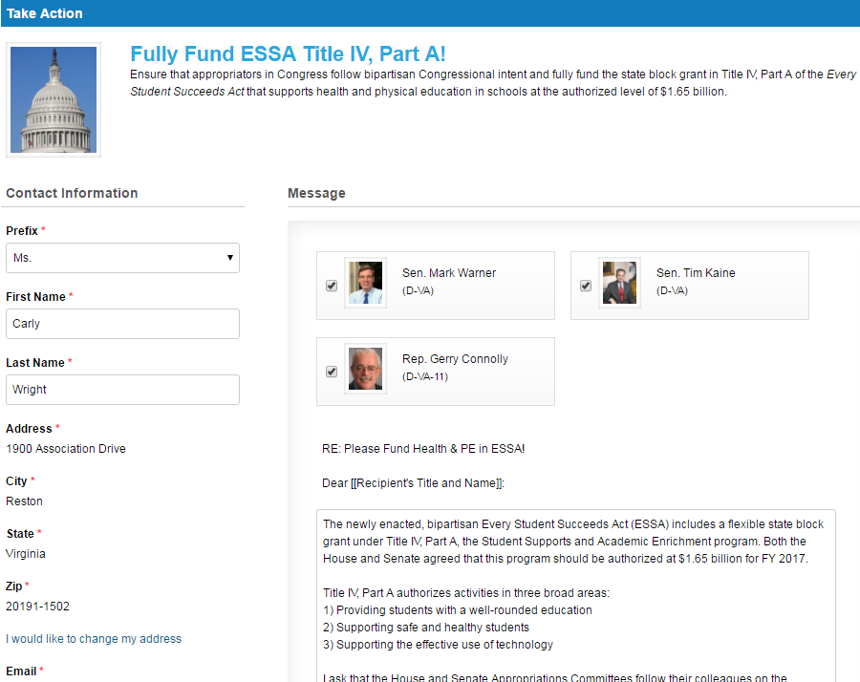
Take Action Now!
Visit the SHAPE America Legislative Action Center at shapeamerica.org/advocacy
to contact your members of Congress to ask for #MoreTitleIV!

Slide 19

State & School District Plans
Health and PE must be represented on committees drafting plans
Important to partner with key advocacy groups in your state/school district
Ensure you are connected to opportunities to provide feedback
Check with DOE for schedule of town hall meetings & other opportunities for feedback
Be prepared for school district needs assessments
FUNDING!!!

Slide 20

Engage Stakeholders
Educators & Parents are required to be included!
Title Coordinators
Principals
Superintendents
State education agency
State board of education
Governor
State commissioner of education
State NEA/AFT
School boards
Community partners
PTA/PTO

Slide 21
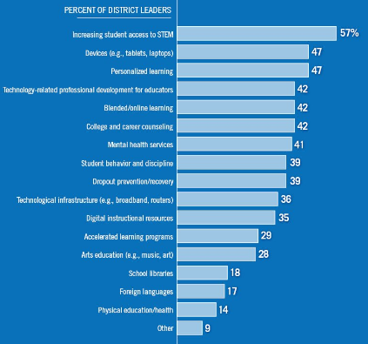
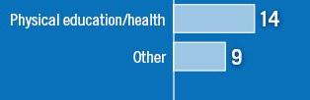
School District Priorities for ESSA Funding
District Leaders indicated programs they would fund with Title IV, Part A funding

Slide 22
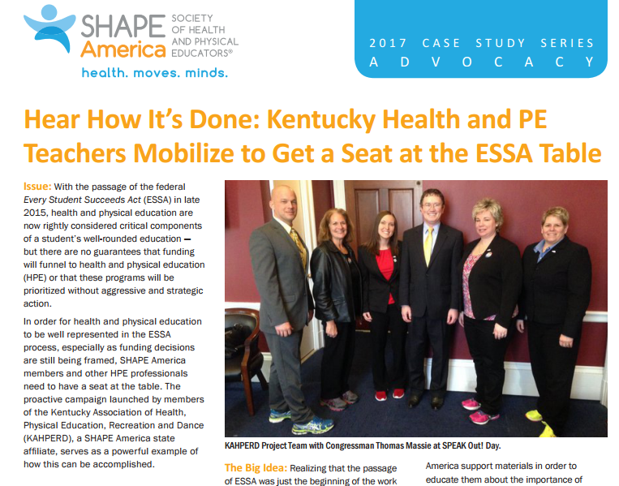
“Kentucky serves as a great example of what states can accomplish when they take the lead and spread our important message. This is a critical time for us to ensure that health and physical education programs get access to funding and support.”

Slide 23
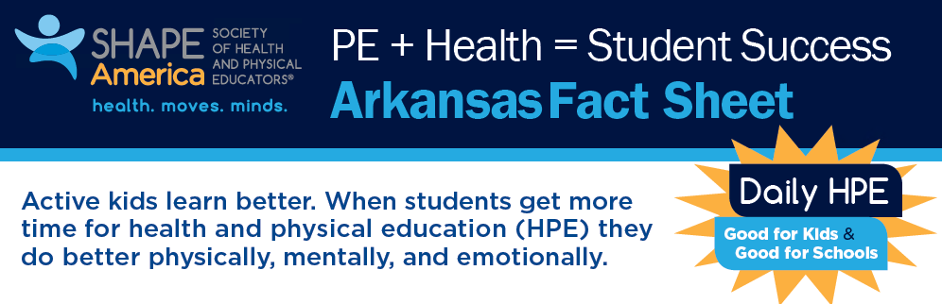
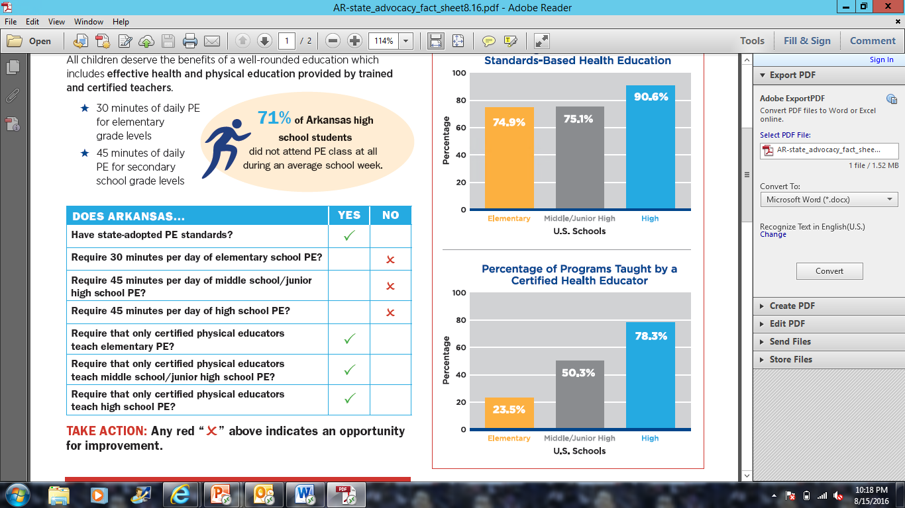
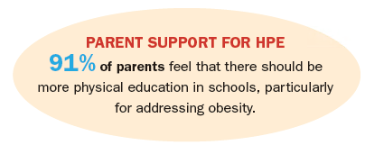

Slide 24

ArkAHPERD Advocates for YOU!
www.arkahperd.hypermart.net

Slide 25

Arkansas Education Stakeholders
Key Contacts
  Audra Walters, Dept of Ed PE Specialist, 501-683-3604
  Kathleen Courtney, Dept of Ed HPE Specialist, 501-683-3604
  Leesa Freasier, Dept of Health PA Specialist, 501-280-4915
Arkansas Department of Education
  ESSA Information
  Arkansas Department of Education
  Department of Education, Health & Physical Education
Education Stakeholders
  Chief State School Officer
  Arkansas PTA
  Arkansas Educational Administrators
  Governor Asa Hutchinson
Right-click contacts to open the hyperlink!

Slide 26

What Can We Do?
Educate yourself on ESSA
Educate others on the opportunities for HPE
Engage in state & school district level discussions & planning on ESSA
Advocate for funding on the federal, state, and local level
Be the positive change agent that your state needs!
CALLING ALL ADVOCATES!

Slide 27
Top 10 Tools for ESSA
1
Getting Started with ESSA – become the expert on ESSA with this free, 20-page e-guide
2
ESSA Fact Sheet – get a concise, one-page overview of the new legislation
3
Title IV, Part A Fact Sheet – learn about this new block grant that includes funding for HPE
4
State Advocacy Toolkit – access customized ESSA tools and contact info for each state
5
ESSA Support Letter – use this template to ask key stakeholders to ensure HPE are included in state/local plans
shapeamerica.org/advocacy

Slide 28
Top 10 Tools for ESSA
6
PE + Health = Student Success – share this infographic of benefits of HPE for students
7
ESSA Videos – watch these videos to understand the impact of ESSA on HPE
8
Title IV, Part A Action Alert – contact Congress to ensure sufficient funding is allocated
9
ESSA Impact on HPE PowerPoint – educate key stakeholders with this presentation
10
Be a Backyard Advocate – you don’t have to go all the way to Capitol Hill for your voice to be heard
shapeamerica.org/advocacy

Slide 29


Join SHAPE America
About SHAPE America
SHAPE America – Society of Health and Physical
Educators is the nation’s largest membership organization of health and physical education professionals. The organization sets the standard for health and physical education in the
U.S and is a founding partner of the Presidential Youth Fitness Program, Let’s Move! Active Schools and the Jump Rope
For Heart/Hoops For Heart programs.
Membership in SHAPE America connects you to a national network of thousands of health and physical educators — professionals like you who are committed to teaching the skills and healthy habits that foster a student’s ability, confidence and desire to be physically active for life.
As a member, you’ll receive numerous benefits, including discounts on books and professional development,
a subscription to your choice of award-winning journals, and
free access to webinars, monthly activity calendars and our exclusive online community.
ONLINE COMMUNITY
PROFESSIONAL JOURNALS
WEBINAR LIBRARY
EXCLUSIVE DISCOUNTS
ACTIVITY CALENDARS
STATE AND NATIONAL MEMBERSHIP GIVES YOU MUCH MORE.
Membership in a SHAPE America state affiliate is a terrific complement to national membership. SHAPE America's affiliates are independent organizations, membership in one does not automatically mean membership in another.
Learn more at shapeamerica.org/membership

